Slide 1


Data Analytics with Apache Spark MSDS 7330 Jacob Brionez, Damon Resnick, Trace Smith
Trace Smith
MSDS 6371
Date: 12/8/16

Slide 2
Overview
Motivation:
In an era of Big Data, what is the latest software being utilized in the industry to efficiently process and analyze large scale datasets
Is there a significant advantage to running Spark on top of Relational Databases such as MySQL or Postgres from a standpoint of computation time?
Objective:
Learn about the core components of the Apache Spark Ecosystem
Explore how Spark differs from other big data processing methods such as MapReduce
Understand at a high-level the functionality of Resilient Distributed Dataset
Provide a working example of how Spark can be implemented in an analytics workflow (stand alone)
Python Demo
Leveraging Spark for processing a large dataset (i.e. 7 million rows)
Interface through Spark using the PySpark API (Python 3.5)
Provide an in-depth demo in Jupyter Notebook on examples of how to get setup with Spark, querying the data set, creating DataFrames, and creating visualizations using PySpark and other Python libraries

Slide 3
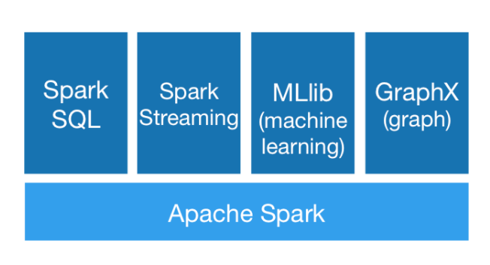
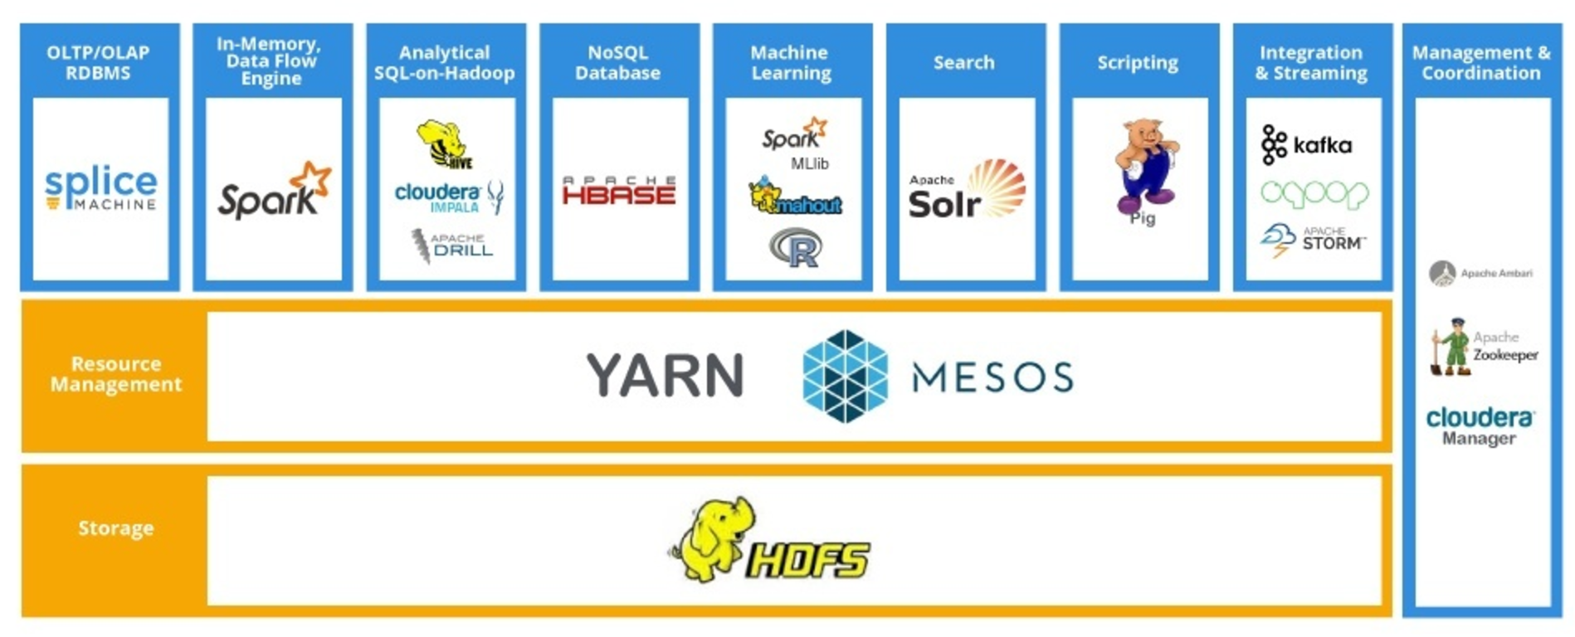
Introduction to Spark
High performance distributed clustering computing systems for large scale data processing
Spark enables applications in Hadoop clusters to run up to 100x faster than MapReduce
Less expensive shuffles in the data processing along with capabilities like in-memory data storage and near real-time processing
Core APIs in R, SQL, Java, Scala, and Python
Spark Ecosystem consists of:
Spark SQL + DataFrames
Spark Streaming
MLlib
GraphX

Slide 4
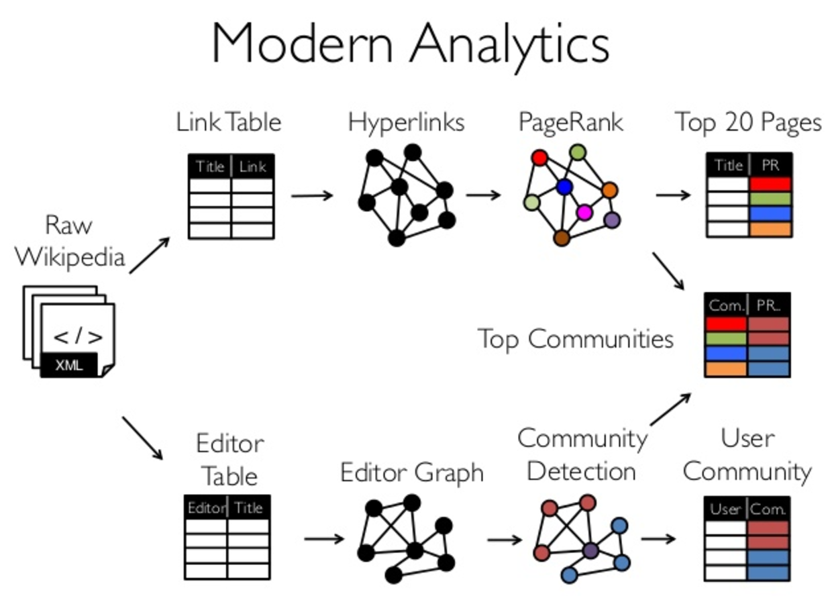
Spark Ecosystem
Spark Streaming:
API used for processing the real-time streaming data (i.e. Twitter)
Spark SQL:
Provides the capability to expose the Spark datasets over JDBC API and allow running the SQL like queries on Spark data (also supports JSON and NoSQL databases)
Spark MLlib:
scalable machine learning library including classification, regression, clustering algorithms
Spark GraphX:
Spark API for graphs and graph-parallel computation (i.e. Page Ranking, Collaborative Filtering, Triangle Counting)
Spark GraphX
https://www.slideshare.net/ankurdave/graphx-ampcamp5

Slide 5
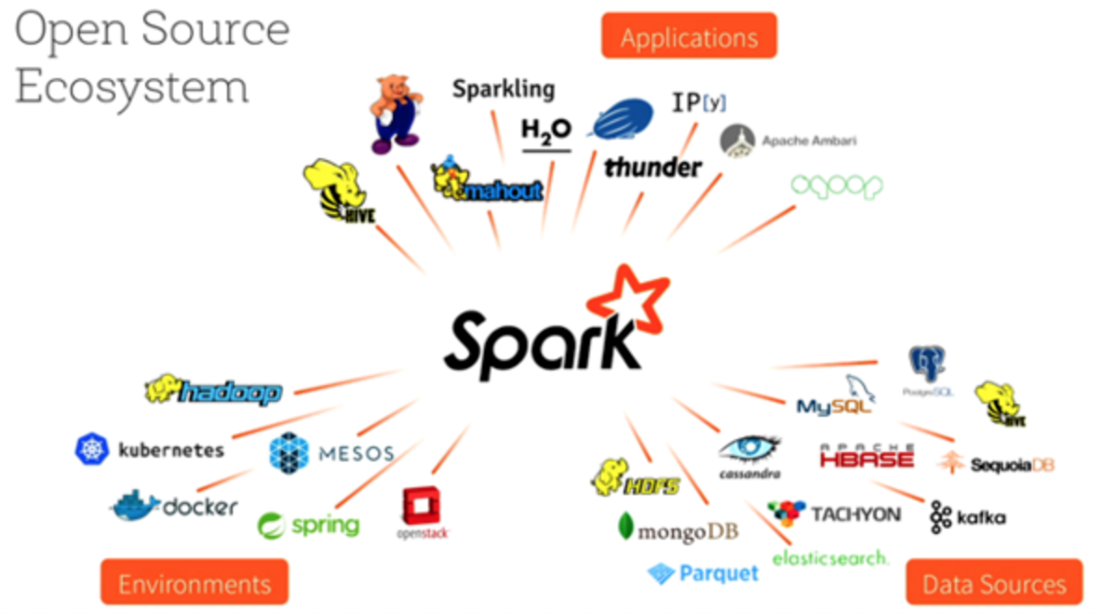
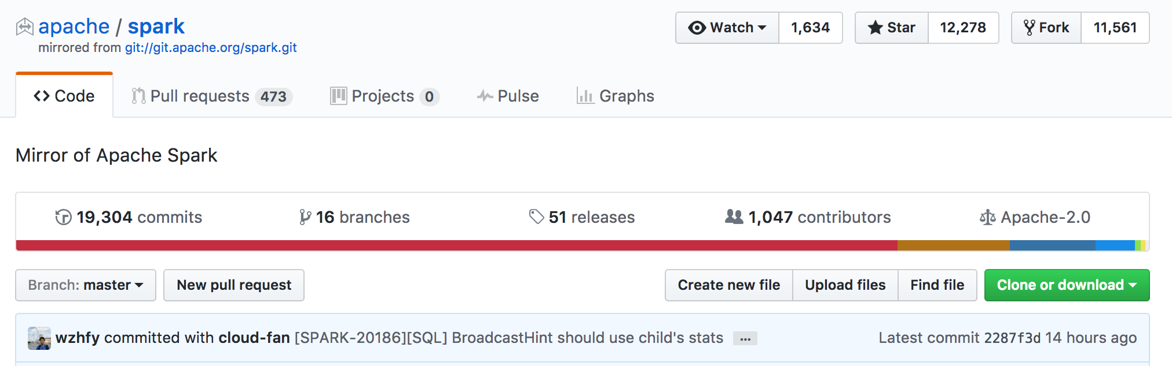
History of Apache Spark
Started as a class project in 2009 at UC Berkley (Created by: Matei Zaharia)
General idea was to build a cluster management framework, to support different kind of cluster computing system
Open sourced in 2010
Project was donated in 2013, to the Apache Software Foundation and switched license to Apache 2.0
Databricks set a new world record in large scale sorting using Spark in 2014.
One of the most active projects in the Apache Software Foundation (~19,000 commits)
Trace Smith
MSDS 6371
Date: 12/8/16
http://spark.apache.org/
https://github.com/apache/spark

Slide 6

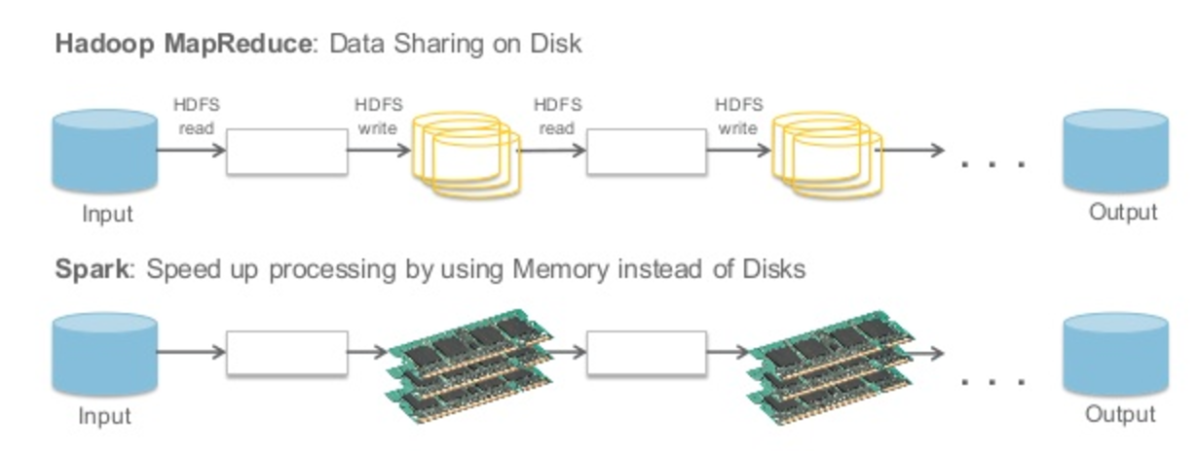
Hadoop
Distributed data infrastructure -- allocates massive data collections across multiple nodes within a cluster of servers
Designed to scale up from single servers to thousands of distributed machines
Consist of two main components:
Hadoop File System (HDFS) – storage
MapReduce – programming framework (i.e. data sharing on disks)
Spark
Framework for Big Data analytics
Data-processing tool that operates on distributed data collections
Does not include it’s own file management system – need to integrate with HDFS or other cloud based platforms
Developed on the basis of parallel data structure known as Resilient Distributed Datasets (stores data in memory)
http://spark.apache.org/

Slide 7
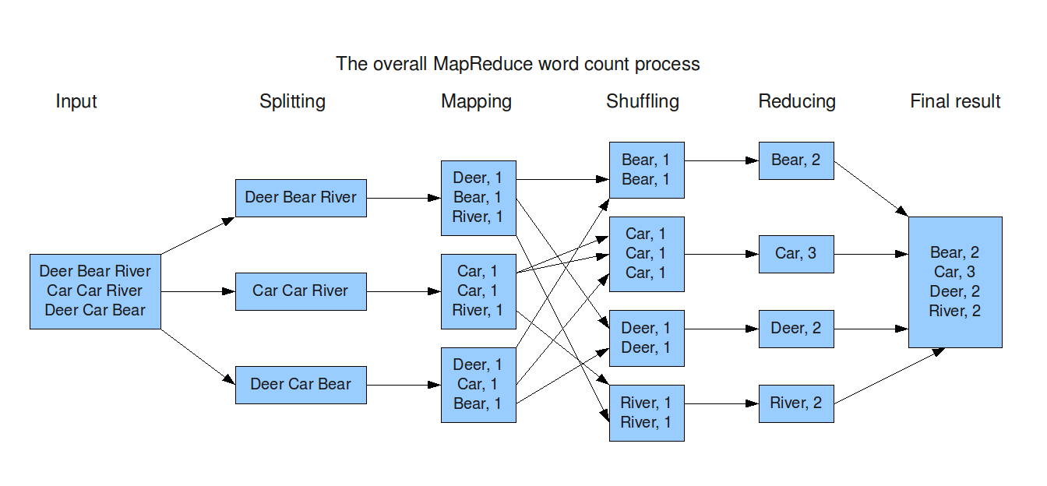
MapReduce
MapReduce is the heart of Hadoop®. It is this programming paradigm that allows for massive scalability across hundreds or thousands of servers in a Hadoop cluster. The MapReduce concept is fairly simple to understand for those who are familiar with clustered scale-out data processing solutions.*
The term MapReduce actually refers to two separate and distinct tasks that Hadoop programs perform. The first is the map job, which takes a set of data and converts it into another set of data, where individual elements are broken down into tuples (key/value pairs). The reduce job takes the output from a map as input and combines those data tuples into a smaller set of tuples.*
http://datascienceguide.github.io/map-reduce
*https://www-01.ibm.com/software/data/infosphere/hadoop/mapreduce/

Slide 8
MapReduce vs. Spark
Spark tries to keep things in memory, whereas MapReduce keeps shuffling things in and out.
MapReduce can be slow and laborious (i.e. repetition and disk storage)
Can be more cumbersome to program in MapReduce
MapReduce inserts barriers, and it takes a long time to read/write from disk.
Spark eliminates this restriction which makes Spark orders of magnitude faster.
It’s easier to develop for Spark.
More powerful and expressive in terms of how you give it instructions to crunch data.
Spark has a Map and a Reduce function like MapReduce.
It also adds others like Filter, Join, and Group-by.
This makes it easier to develop for Spark.
Spark provides for lots of instructions at a higher level of abstraction than MapReduce
Can consist of more than one single map and reduce (i.e. batch processing)
Trace Smith
MSDS 6371
Date: 12/8/16
https://mapr.com/blog/5-minute-guide-understanding-significance-apache-spark/

Slide 9
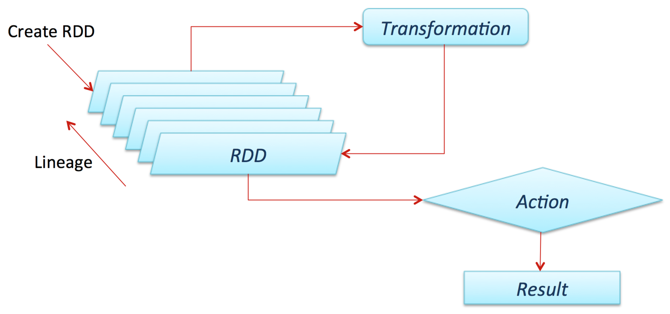
Resilient Distributed Dataset
Resilient Distributed Dataset (RDD) is the primary data abstraction in Apache Spark and the core of Spark.
RDDs are a collection of immutable objects that can be operated on in parallel
Each RDD is split into multiple partitions and distributed over a series of nodes in the cluster
Resilient, i.e. fault-tolerant with the help of RDD lineage graph which enables it to recompute missing or damaged partitions due to node failures.
Distributed with data residing on multiple nodes in a cluster.
Dataset is a collection of partitioned data with primitive values or values of values, e.g. tuples or other objects (that represent records of the data you work with).
https://jaceklaskowski.gitbooks.io/mastering-apache-spark/content/spark-rdd.htm
https://dzone.com/storage/rc-covers/6617-thumb.pngl

Slide 10
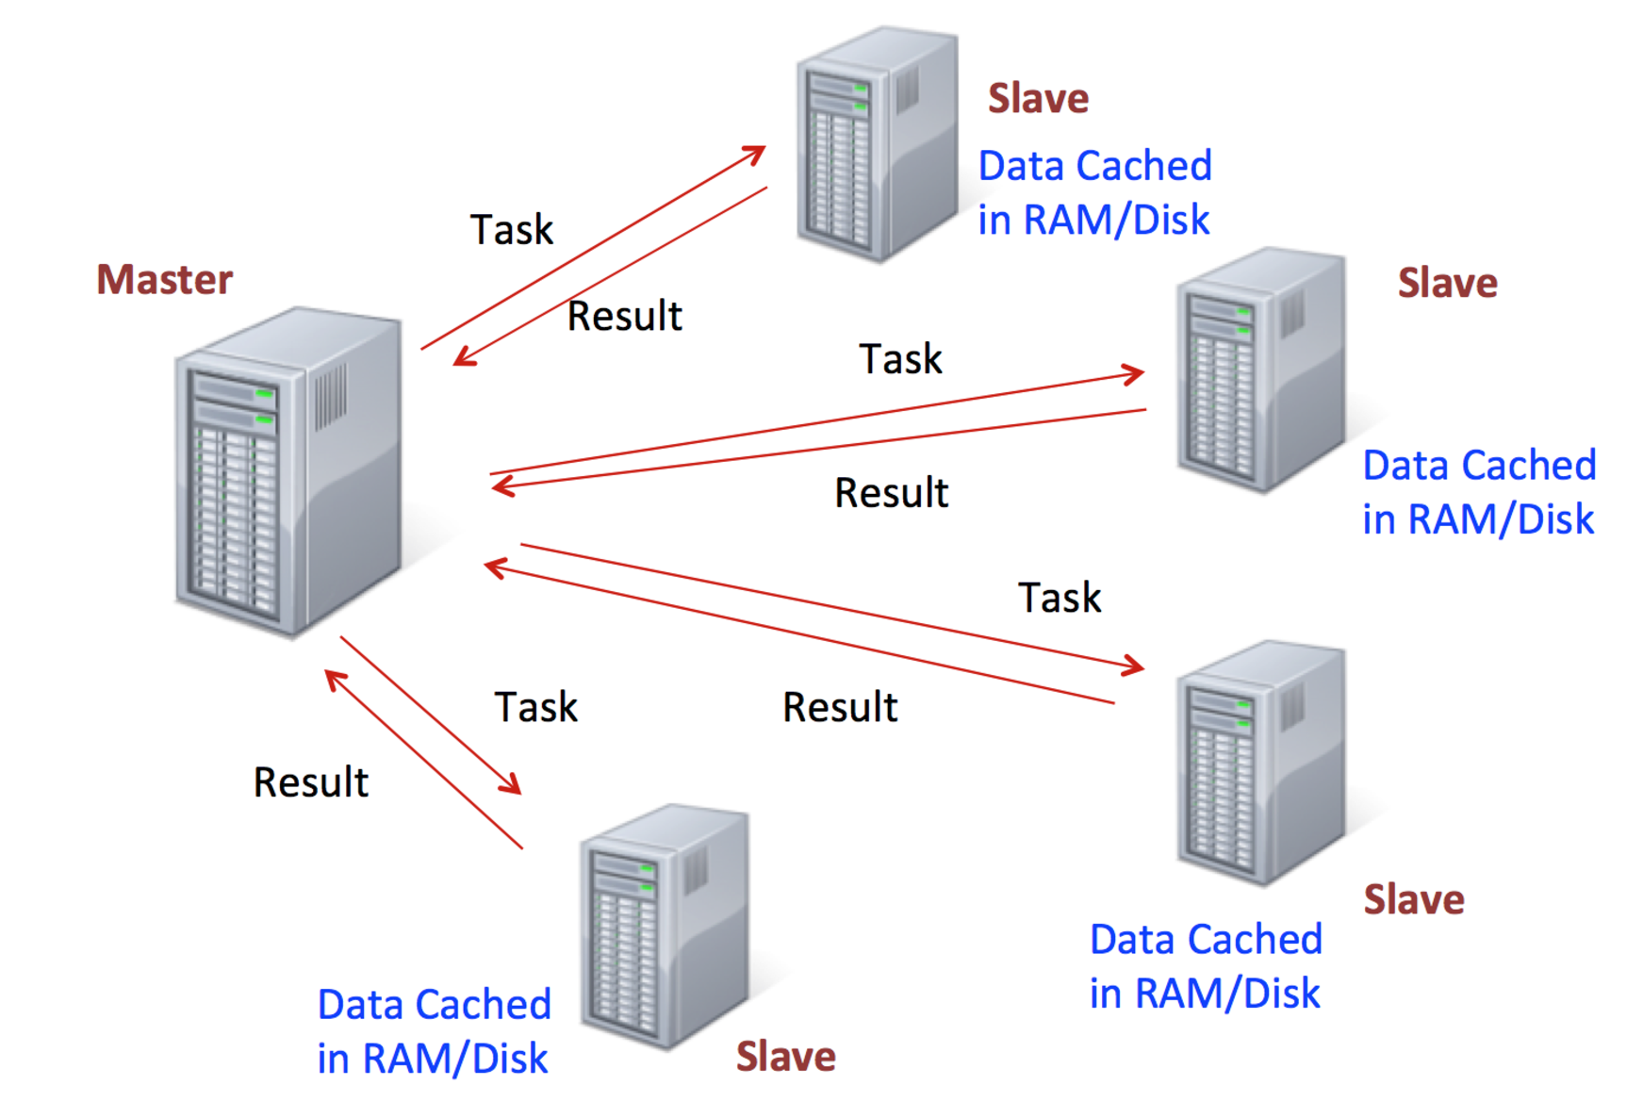
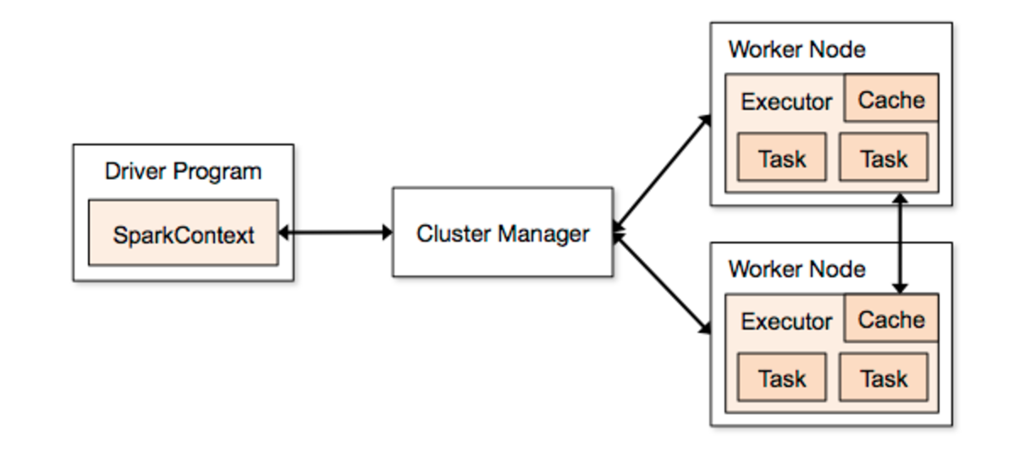
Spark Architecture
Similar structure to Hadoop, Spark uses a master/worker architecture
Cluster Manager allocate resources across applications
Standalone, which is a cluster manager included with Spark that makes it easy to set up a cluster
Run on YARN (Hadoop 2.0), a distributed container manager
Master controls the workflow
Worker launches executors responsible for executing part of the job submitted to the Spark master
Single application can spawn multiple jobs and the jobs run in parallel
Trace Smith
MSDS 6371
Date: 12/8/16

Slide 11
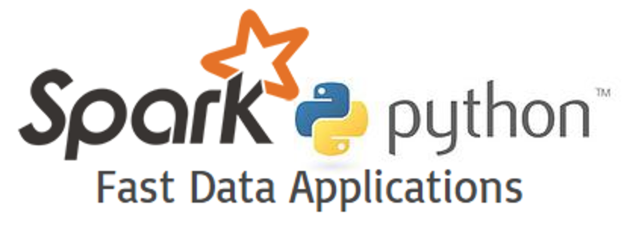
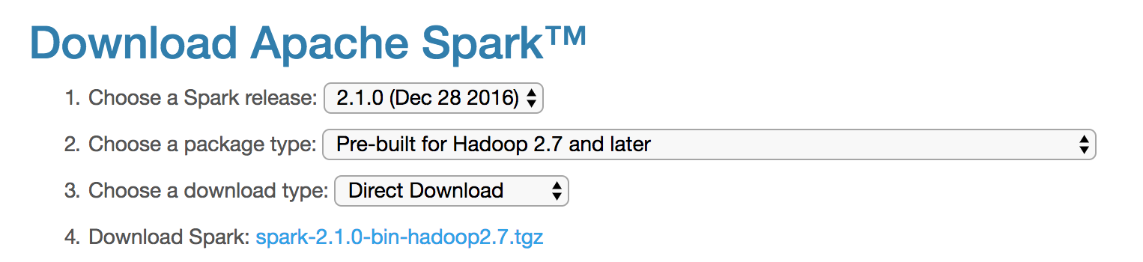
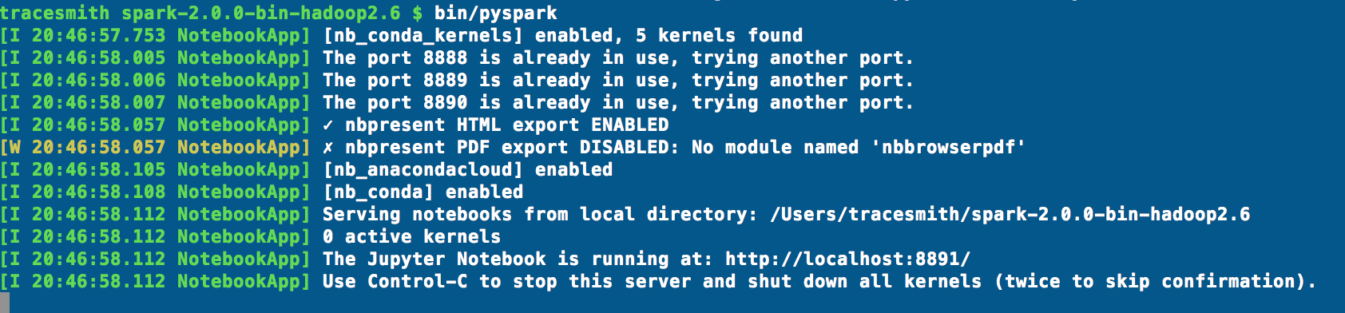
Getting Started with Spark
Pyspark -- Python API interface to with Apache Spark
Install Spark here: http://spark.apache.org/downloads
Unpack .tgz file to root directory
Modify .bash_profile and set-up the following alias:
export SPARK_PATH=~/spark-2.1.0-bin-hadoop2.7
export PYSPARK_DRIVER_PYTHON="jupyter" export
PYSPARK_DRIVER_PYTHON_OPTS="notebook" alias
snotebook='$SPARK_PATH/bin/pyspark --master local[2]’
Launch Pyspark from shell: bin/pyspark
Trace Smith
MSDS 6371
Date: 12/8/16
Launching IPython Notebook

Slide 12
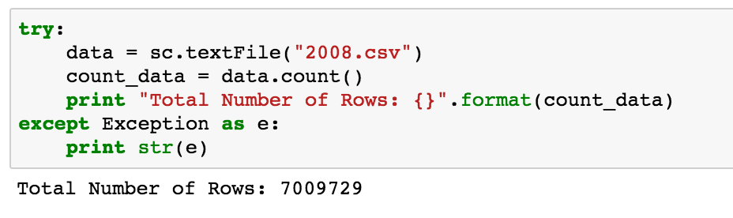
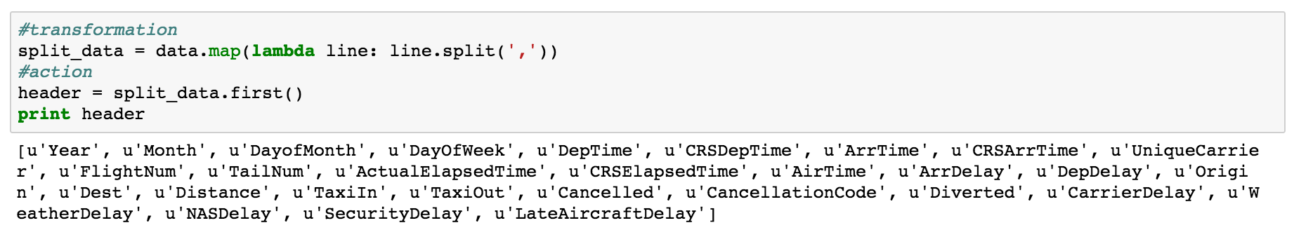
PySpark Example
Examine historical flight data from 2008 recorded by the U.S. Bureau of Transportation Statistics
11 Various Attributes and roughly 7 million rows of data!
File size 650MB
Source: http://stat-computing.org/dataexpo/2009/the-data.html
RDD is a collection of elements that are segmented across multiple nodes in a cluster in which can be processed in parallel
Two operations can be performed on an RDD:
Transformation: operation applied on a RDD which will creates new RDDs (i.e. map)
Action: aggregates output of the transformation by applying some computation (i.e. reduce)
Example of performing a transformation and action

Slide 13
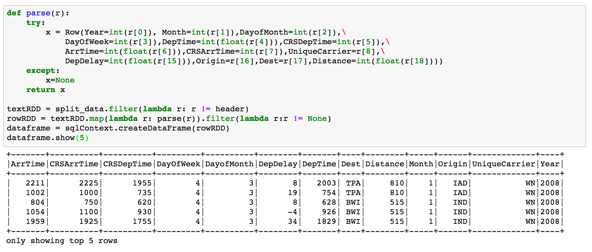
PySpark Example
After loading in csv file to memory, parse the file by splitting on “ , ”
Read data into Spark DataFrame
In Spark, a DataFrame is essentially equivalent to a table in a relational database or a data frame similar to Pandas (i.e. Python)
DataFrames can be constructed from other sources such as structured data files, tables in Hive, external databases, or existing RDDs.
Transformation
Action

Slide 14
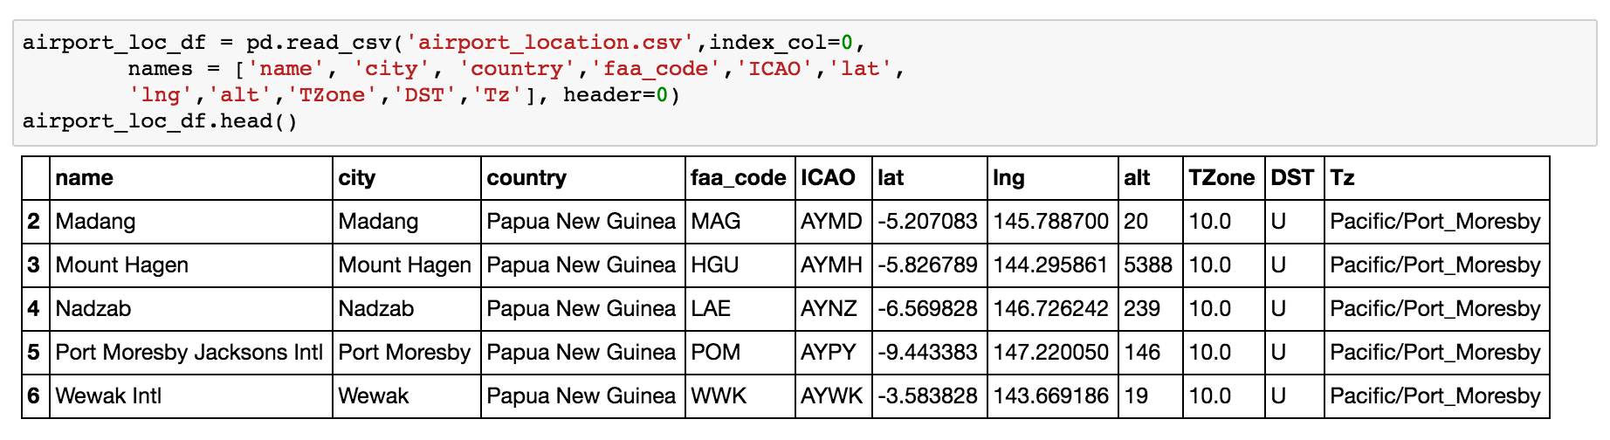
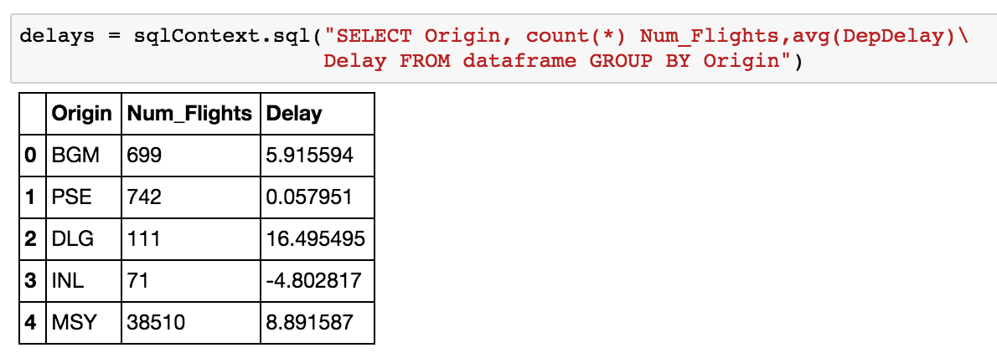
PySpark Example
Load in Airport Location Data
Spark SQL: module for working with structured data (i.e. DataFrame)
Can Connect Pyspark directly to a NoSQL database like MongoDB
sqlContext.read.format("com.mongodb.spark.sql").load()
Convert RDD to DataFrame and Dataset
MongoRDD class provides helpers to create DataFrames
SQL: Which airport has the most delays?
PySpark SQL Class:
from pyspark.sql import SQLContext

Slide 15
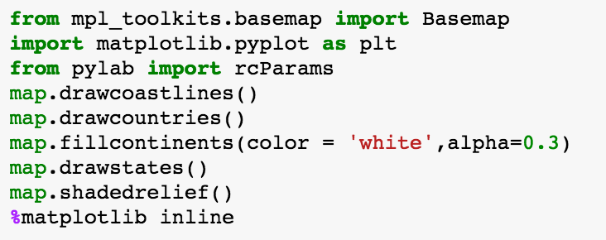
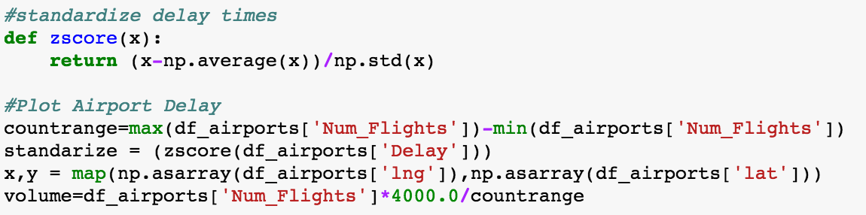
PySpark Example
Setup visualization of delayed flights across the U.S. in 2008
First Load in matplotlib toolkit “Basemap” (i.e. plot contours lines for U.S.)
Join the two DataFrames on “Origin” and “FAA_Code” – Joining Flight Information and Airport Location DataFrames
Standardize the delay time and store the coordinates of the airports in x,y variables
Adjust the magnitude of flights (i.e. for visualization rendering purposes)

Slide 16
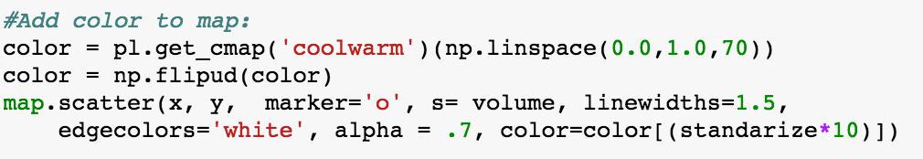
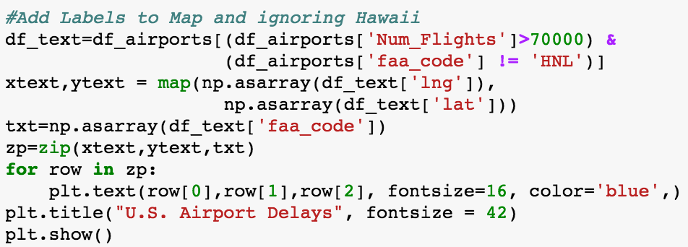
PySpark Example
Set up coordinates system in Basemap for U.S.
Create scatter plot of latitude and longitude locations of airport
Size of the data point is based on the magnitude of delayed flight times
Add labels to airports and exclude Hawaii and only add labels if the number of flights for the corresponding airport exceeds 70,000

Slide 17
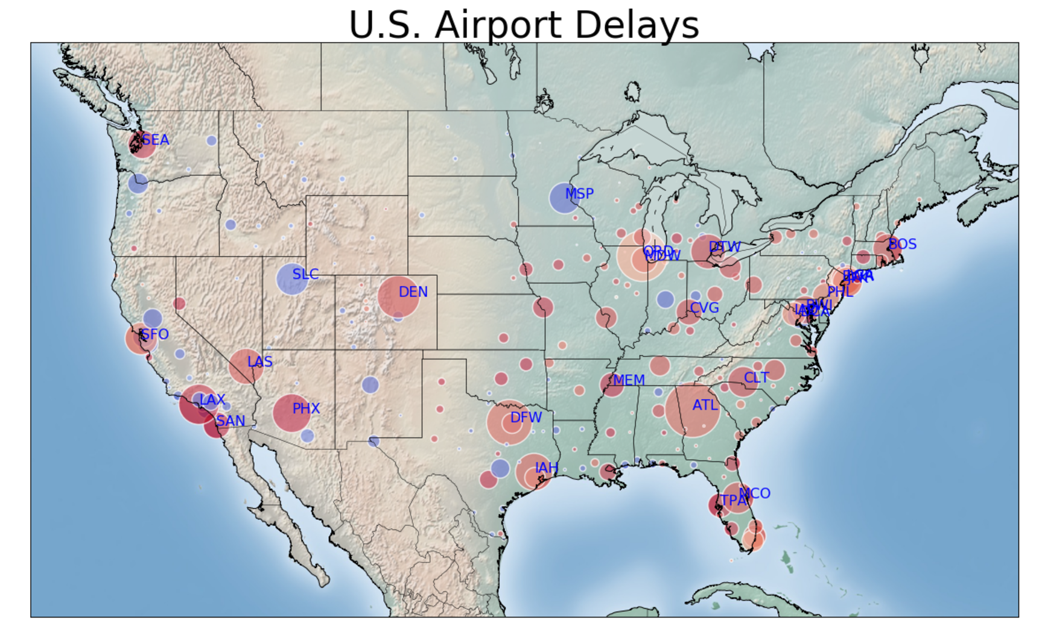
PySpark Example

Slide 18
References
http://datascienceguide.github.io/map-reduce
https://www-01.ibm.com/software/data/infosphere/hadoop/mapreduce/
https://jaceklaskowski.gitbooks.io/mastering-apache-spark/content/spark-rdd.html
Demo: IBM Data Science Workbench -- Spark Tutorial
https://datascientistworkbench.com/
Trace Smith
MSDS 6371
Date: 12/8/16

